Slide 1
Achieve a Vision Beyond Your Sight
Presented by:
Dr. Randy Pierce, President & CEO of Future In Sight

Slide 2
WHO WE ARE
Formerly the New Hampshire Association for the Blind
110 years of service
Clients of all ages from low vision to no vision
We believe a better future is in sight with Future In Sight

Slide 3
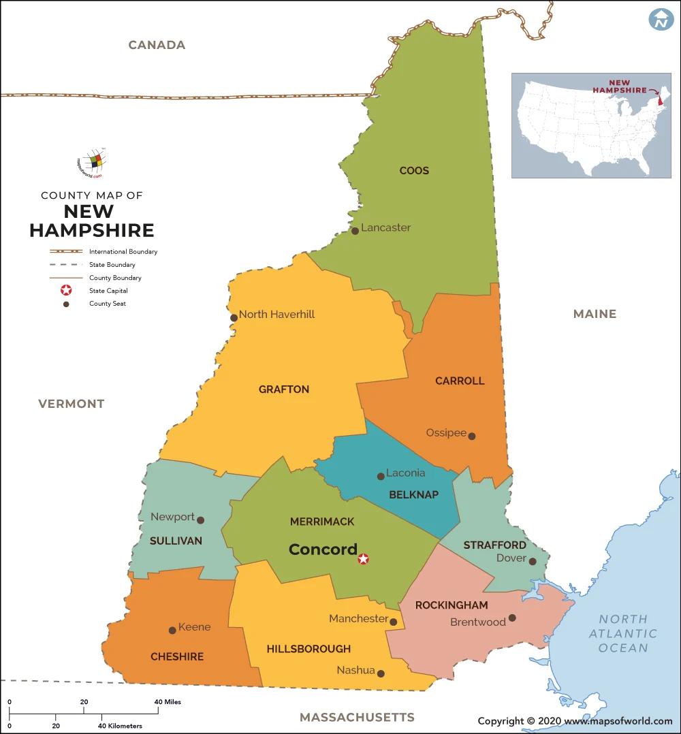
Future In Sight Clients Per County
County | # of Clients
Belknap | 634
Carroll | 388
Cheshire | 621
Coos | 376
Grafton | 762
Hillsborough | 3,698
Merrimack | 1,706
Rockingham | 1,807
Strafford | 781
Sullivan | 417
376 clients
634 clients
388
clients
762 clients
781 clients
1,807 clients
417 clients
1,706 clients
621 clients
3,698 clients

Slide 4
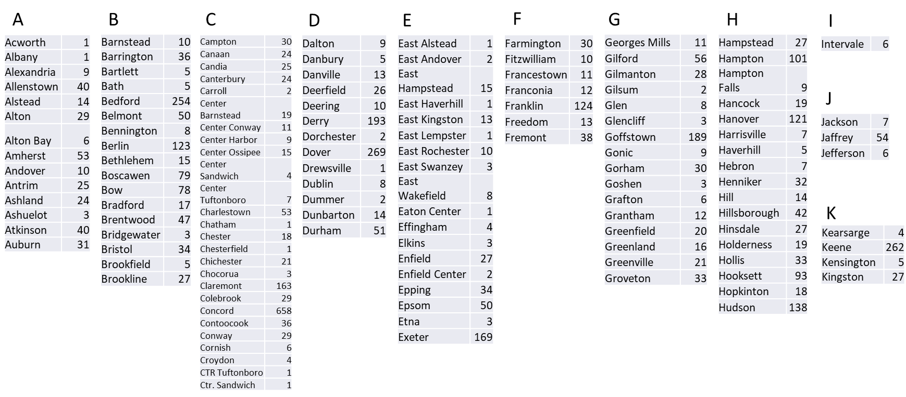
Future In Sight Clients Per County

Slide 5
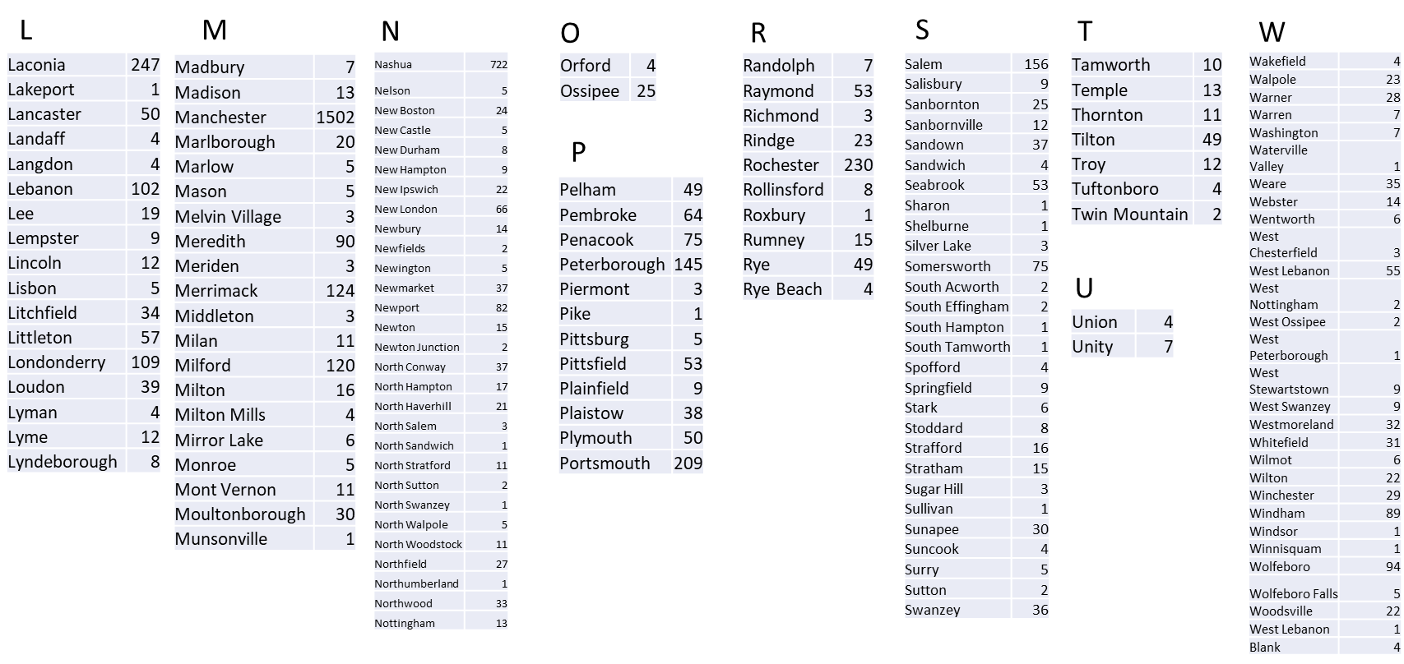
Future In Sight Clients Per County

Slide 6
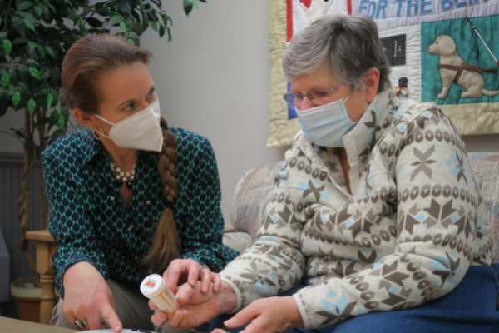
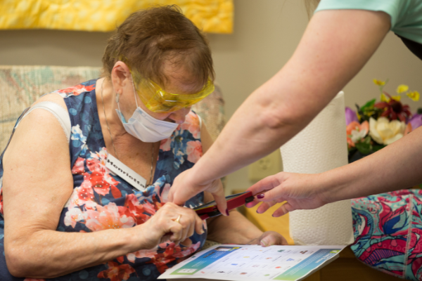
WHAT WE DO
Adult Services
Youth Services
Educational Services
Parent Services
TEAP Program
Volunteer Services including
Client Ride Program and Friendly Calls Program

Slide 7
HOW TO REFER
Familiarize yourself with the referral form that your office currently has
Contact our Care Coordination Team with any questions by calling 603-224-4039 or emailing services@futureinsight.org

